Slide 1
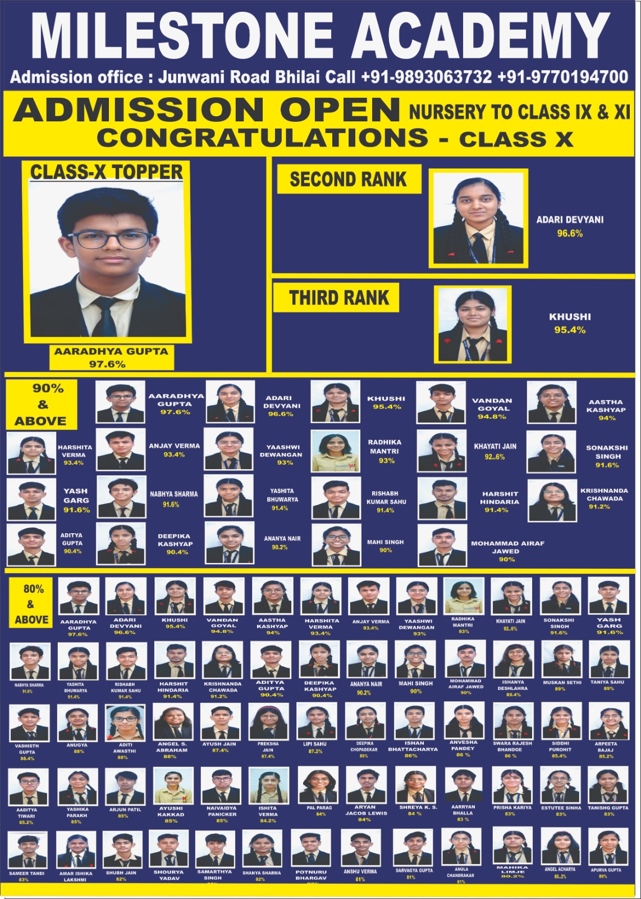

Slide 2
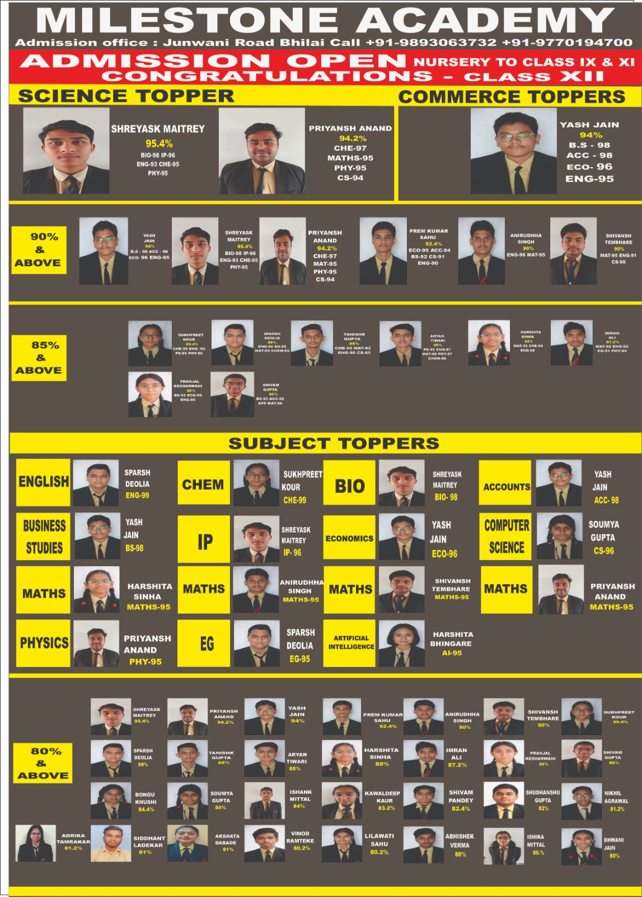

Slide 3
MILE STONE ACADEMY
WELCOMES YOU TO

Slide 4
ACHIEVEMENTS SECTION

Slide 5


SPORTS ACHIEVEMENT

Slide 6

INTER-DISTRICT CRICKET TOURNAMENT
SEC – 10, BHILAI
SATYAM DHRITLAHRE 10E (MAN OF THE MATCH)
NIKHIL KSHATRIYA 11E
SANIDDHYA SHUKLA 9E
ANSH AGARWAL 10B
ABHIST DEWANGAN 9A
SIDDHARTH JAIN 9B
KARAN SUNDRANI 9A

Slide 7
INTER-DISTRICT CRICKET TOURNAMENT
SEC – 10, BHILAI
SWASTIK SHUKLA 9F
SACHIN KUMAR 8D
CHANDRANSH YADAV 9A
YUG KHAR 9E
LAKSHYA TAPADIYA 9B
NISHANT NAGPURE 9E
ISHAAN 9D

Slide 8
AT SHANKRA VIDYALAY
INTER SCHOOL TOURNAMENT
SATYAM DHRITLAHRE
MAN OF THE MATCH

Slide 9
CBSE NATIONAL TOURNAMENT
NAME | CLASS | SPORT | ACHIEVEMENT
MUSKAN CHAUHAN | 9D | BOXING | 1st
SAHIL KUMAR BANDHE | 10E | BOXING | PARTICIPATION
SARVAGYA GUPTA | 11C | BOXING | PARTICIPATION
MD. TETEKHAR AHMED | 11B | BOXING | PARTICIPATION
KRISHNANDA CHAWDA | 11B | JUDO | PARTICIPATION
AYAAN AHMED KHAN | 10D | JUDO | PARTICIPATION

Slide 10
CBSE NATIONAL TOURNAMENT
NAME | CLASS | SPORT | ACHIEVEMENT
ADARSH GUPTA | 9D | ROPE SKIPPING | PARTICIPATION
ARYAN VERMA | 9D | ROPE SKIPPING | PARTICIPATION
VICTOR KUMAR | 10th | ROPE SKIPPING | PARTICIPATION
VARNIKA SHARMA | 5B | GYMNASTIC | PARTICIPATION
PRIYANSHU SAHU | 9E | ROPE SKIPPING | PARTICIPATION

Slide 11
CBSE FEZ-ZONAL TOURNAMENT
NAME | CLASS | SPORT | ACHIEVEMENT
MUSKAN CHAUHAN | 9D | BOXING | 1st
SAHIL KUMAR BANDHE | 10E | BOXING | 2nd
SARVAGYA GUPTA | 11C | BOXING | 2nd
MD. TETEKHAR AHMED | 11B | BOXING | PARTICIPATION
HIRANYA SAHU | 7E | JUDO | PARTICIPATION

Slide 12
CBSE FEZ-ZONAL TOURNAMENT
NAME | CLASS | SPORT | ACHIEVEMENT
PIYUSH SAHU | 10E | JUDO | 3rd
SUYASH DUBEY | 8B | BADMINTON | PARTICIPATION
GULZAR ALI | 7A | BADMINTON | PARTICIPATION
SURYANSH SAHU | 11C | ARCHARY | 5th RANK

Slide 13
CBSE CLUSTER II TOURNAMENT
NAME | CLASS | SPORT | ACHIEVEMENT
MANVEER SINGH | 10th | VOLLEYBALL | RUNNER (SILVER)
DIVYANSHU CHAURASIYA | 10th | VOLLEYBALL | RUNNER (SILVER)
HARSHIT HINDARIYA | 11th | VOLLEYBALL | RUNNER (SILVER)
DHAIRYA KUMAR JANGHEL | 9th | VOLLEYBALL | RUNNER (SILVER)
LILESH DESHMUKH | 9th | VOLLEYBALL | RUNNER (SILVER)
TANRAJ SINGH SAINI | 11th | VOLLEYBALL | RUNNER (SILVER)
DEEPAK SINGH | 12th | VOLLEYBALL | PARTICIPATION
ATHARV CHANDRAKAR | 12A | VOLLEYBALL | PARTICIPATION

Slide 14
CBSE CLUSTER II TOURNAMENT
NAME | CLASS | SPORT | ACHIEVEMENT
ROSHAN SAHU | 10th | VOLLEYBALL | RUNNER (SILVER)
PRASSAN TIWARI | 12th | VOLLEYBALL | PARTICIPATION
YASH JAGYASI | 12th | VOLLEYBALL | PARTICIPATION
PANKAJ GUPTA | 11th | VOLLEYBALL | PARTICIPATION
TANJEET SINGH SAINI | 12A | VOLLEYBALL | PARTICIPATION
MOKSH SINGH BAIS | 12th | VOLLEYBALL | PARTICIPATION
KRISHNA CHAURASIYA | 12th | VOLLEYBALL | PARTICIPATION

Slide 15
SGFI NATIONAL TOURNAMENT
NAME | CLASS | SPORT | ACHIEVEMENT
MUSKAN CHAUHAN | 9D | BOXING | PARTICIPATION
ANSH GAJBHIYE | 10E | BOXING | PARTICIPATION
PIYUSH SAHU | 10E | JUDO | PARTICIPATION
AARAV JAIN | 7B | TABLE TENNIS | GOLD
ANUBHAV GUPTA | 12th | GYMNASTIC | POETIC PONT

Slide 16
SGFI STATE TOURNAMENT
NAME | CLASS | SPORT | ACHIEVEMENT
ANSH GAJBHIYE | 10E | BOXING | 1st
AYAAN AHMED KHAN | 10D | JUDO | 3rd
PIYUSH SAHU | 10E | JUDO | GOLD
HOOMAING NUKHARE | 7E | JUDO | PARTICIPATION

Slide 17
SGFI STATE TOURNAMENT
NAME | CLASS | SPORT | ACHIEVEMENT
ADITI MISHRA | 8D | GYMNASTICS | PARTICIPATION
ABHINAV | 8B | CHESS | 8th RANK
AARAV JAIN | 7B | TABLE TENNIS | GOLD
AKSHITA VERMA | 6E | VOLLEYBALL | RUNNER (2nd )
SURYANSH SAHU | 11C | ARCHARY | PARTICIPATION

Slide 18
CBSE CLUSTER FEZ COMPETITION
NAME | CLASS | SPORT | ACHIEVEMENT
KRISHNANDA CHAWDA | 11B | JUDO | 1st
AYAAN AHMED KHAN | 10D | JUDO | 2nd
PIYUSH SAHU | 10E | JUDO | 3rd

Slide 19
OTHER TOURNAMENTS
NAME | CLASS | ACHIEVEMENT | TOURNAMENT NAME
SAHIL KUMAR BANDHE | 11B | PARTICIPATION | M.M.A. OPEN TOURNAMENT
SUYASH DUBEY | 8B | PARTICIPATION | OPEN BADMINTON COMPETITION 2024
GULZAR ALI | 7A | PARTICIPATION | INTER CLUB TOURNAMENT

Slide 20
OTHER TOURNAMENTS
NAME | CLASS | ACHIEVEMENT | TOURNAMENT NAME
AMAN CHANDA | 9F | BRONZE | SHEITOKAI KARATE TOURNAMENT
ADITI DESHMUKH | 10C | BLACK BELT 1st RANK | OPEN TAIKWANDO TOURNAMENT
SAMBHAV JHA | 12E | MAN OF THE MATCH (WINNER) | PRAMVEER ALBERT EKKA FOOTBALL AUGUST 2024

Slide 21
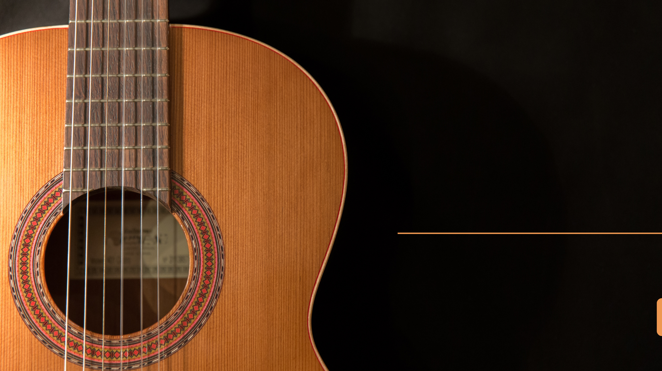
MUSIC
ACHIEVEMENT

Slide 22
SOLO MUSIC
ALL INDIA MUSIC & DANCE COMPETITION
NAME | CLASS | CATEGORY | AWARDED IN
ANSHURTA | 7th | SINGING COMPETITION | 1st PRIZE IN "GEETANSH UTSAV-2024"
VAIBHAV DIXIT | 7th | INSTRUMENTAL GUITAR | 2nd POSITION "DESH RAAG" 2024
APURVA GUPTA | 11th | SEMI CLASSICAL SINGING | 1st POSITION "NAADOTSAV-2024"
ANSHURTA | 7th | SINGING COMPETITION | 1st PRIZE IN "GEETANSH UTSAV-2024"

Slide 23
DANCE
NAME | CLASS | CATEGORY | AWARDED IN
HARSHIDHI SAMAL | 6B | WESTERN DANCE | 1st PRIZE IN "ALL INDIA MUSIC & DANCE COMPETITION "
VARUSHTHA RATHOD | 6B | FOLK DANCE | 3rd POSITION IN "DESH RAAG 2024" "ALL INDIA MUSIC & DANCE COMPETITION"
ANIKA ROY | 6B | WESTERN DANCE | 3rd POSITION IN DESH RAAG ALL INDIA MUSIC & DANCE COMPETITION
AASTHA AGRAWAL | 8E | FOLK DANCE | 3rd RANK IN ALL INDIA MUSIC & DANCE COMPETITION

Slide 24
DANCE
NAME | CLASS | CATEGORY | AWARDED IN
JAHNAVI SHARMA | 8E | WESTERN | 2nd RANK IN KRISHNAPRIYA DANCE COMPETITION
SHIKHA SINGH | 7D | FUSION | 1st IN DESH RAAG AND AWARDED IN INTERNATINAL COMPETITION
BHAVYA JAIN | 7C | WESTERN | 1st PRICE IN INTERNATIONAL COMPETITION
PALAK JIGYASI | 8A | KATHAK | 3rd PRIZE IN PRAGYOTSAV ALL INDIA MUSIC AND DANCE COMPETITION

Slide 25
DANCE
NAME | CLASS | CATEGORY | AWARDED IN
ANSHIKA BHUTDA | 8A | BHARATNATYAM | INTERNATIONAL PRICE
DEVPRIYA SARJITH | 8C | BHARATNATYAM | 1st IN NRITYANARTAN COMPETITION
CHESHTHA RAHUL | 8C | BHARATNATYAM | 1st & 3rd IN DESH RAAG ALL INDIA MUSIC AND DANCE COMPETITION
ARYA VERMA | 11 | KATHAK | AWARDED NRITYASHREE IN INTERNATIONAL COMPETITION CUTTAK

Slide 26
DANCE
NAME | CLASS | CATEGORY
AAROSHI TIWARI | 4th | SOLO KATHAK DANCE
AWARDED IN
1) 2nd POSITION IN DESH RAAG NATIONAL DANCE COMPETITION
2) 3rd POSITION IN PRAGYOTSAV NATIONAL CULTURE EXTRAVAGANZAA
3) 2nd POSITION IN NRITYA NARTAN NATIONAL FESTIVAL

Slide 27

ACADEMICS

Slide 28


SCIENCE OLYMPIAD
Mathematics Olympiad
CLASS - 1
CLASS - 2
1st AVYUKT SONI
1st PRAKHAR GUPTA
2nd SAMRIDDHI SINGH
2nd SHOURYA SINGH
3rd AARYANSH AGARWAL
3rd TUSHAR SAHU

Slide 29
SCIENCE OLYMPIAD
Mathematics Olympiad
CLASS - 3
CLASS - 4
1st SHASHTI CHANDRAKAR
1st VIBHOR CHHARA
2nd KHUSH KESHWANI
3rd OORVI SAXENA

Slide 30
SCIENCE OLYMPIAD
Mathematics Olympiad
CLASS - 5
CLASS - 6
1st ALEENA MANOJ
1st ISHIKA KESHWANI
2nd ANSH BHARTIYA
2nd ABHIRAJ THAKUR
3rd AADITRI AGARWAL
3rd ATHARVA AGARWAL

Slide 31
SCIENCE OLYMPIAD
Mathematics Olympiad
CLASS - 7
CLASS - 8
1st OJAS CHANDRAKAR
1st M. PRATHMESH
2nd MANU SAHU
2nd DRON ADITYA SAHU
3rd MOKSHIKA SAHU
3rd ANSH DUTT KHOLIYA

Slide 32
SCIENCE OLYMPIAD
Mathematics Olympiad
CLASS - 9
CLASS - 10
1st SWAYAM SAHU
1st KHUSHI
2nd ABHIGYAN BADKUR
2nd YASHWI DEWANGAN
3rd SHUBHI PARAKH
3rd HARSHITA VERMA

Slide 33
SCIENCE OLYMPIAD
English Olympiad
CLASS - 2
CLASS - 3
1st ANKITA PARKAR
1st OORVI SAXENA

Slide 34
SCIENCE OLYMPIAD
English Olympiad
CLASS - 5
CLASS - 6
1st ANIKA ROY
1st ISHAQ AHMED SIDDIQUE
2nd SONAKSHI GUPTA
3rd ADRIJA SAHU

Slide 35
SCIENCE OLYMPIAD
English Olympiad
CLASS - 7
CLASS - 8
1st MANU SAHU
1st M. PRATHMESH
1st DIKSHA VERMA

Slide 36
SCIENCE OLYMPIAD
Science Olympiad
CLASS - 1
CLASS - 3
1st AVYUKT SONI
1st LAKSHAY KUMAR

Slide 37
SCIENCE OLYMPIAD
Science Olympiad
CLASS - 5
CLASS - 6
1st SAUBHAGYA YADAV
1st ANSHRUTA
2nd DUPESH KUMAR
2nd ATHARAV YENDE
3rd AASHI GAUTAM
3rd POORVA VAISHNAV

Slide 38
SCIENCE OLYMPIAD
Science Olympiad
CLASS - 7
CLASS - 8
1st MOKSHIKA SAHU
1st ANSH DUTT KHOLIYA
2nd CHESHTA RAHUL
2nd M.PRATHMESH
3rd SHOURYA DEWANGAN
3rd SHASHWAT KU. SAHU

Slide 39
SCIENCE OLYMPIAD
Science Olympiad
CLASS - 9
CLASS - 10
1st ABHIGYAN BADKUR
1st KHUSHI
2nd SWAYAM SAHU
2nd PREKSHA JAIN
3rd TANJEET SAINI
3rd ISHANYA DESHLAHRA

Slide 40
SCIENCE OLYMPIAD
GK Olympiad
CLASS - 1
CLASS - 2
1st AARYANSH AGARWAL
1st KOESHA TIKARIHA

Slide 41
SCIENCE OLYMPIAD
GK Olympiad
CLASS - 3
CLASS - 5
1st KHUSH KESHWANI
1st AKSHITA VERMA
2nd ANIKA ROY
3rd INAAYA KHAN

Slide 42
SCIENCE OLYMPIAD
GK Olympiad
CLASS - 7
CLASS - 8
1st MOKSHIKA SAHU
1st SANSKRUTI JENA
2nd AARNA AGARWAL
3rd JAYAN VERMA

Slide 43
SCIENCE OLYMPIAD
Social Studies Olympiad
CLASS - 3
CLASS - 5
1st KHUSH KESHWANI
1st ALEENA MANOJ

Slide 44
SCIENCE OLYMPIAD
Social Studies Olympiad
CLASS - 7
1st CHESHTA RAHUL

Slide 45
SPELL BEE
NAME | CLASS | RANK | LEVEL
AADYA TAMRAKAR | 2A | - | SCHOOL LEVEL
KOESHA TIKARINA | 2A | - | SCHOOL LEVEL
AAROSHI PANDEY | 2nd | - | SCHOOL LEVEL
RIANSHI DIXIT | 3B | - | SCHOOL LEVEL
AAHIL SABRY | 5E | - | SCHOOL LEVEL
ARIV SINGH | 5B | - | SCHOOL LEVEL

Slide 46
SPELL BEE
NAME | CLASS | RANK | LEVEL
AADYA TAMRAKAR | 2A | - | INTERSCHOOL
KOESHA TIKARINA | 2A | - | INTERSCHOOL
RIANSHI DIXIT | 3B | - | INTERSCHOOL
ARIV SINGH | 5B | - | INTERSCHOOL
RIANSHI DIXIT | 3B | 16th | STATE RANK
RIANSHI DIXIT | 3B | 59th | NATIONAL RANK

Slide 47
Handwriting
SPELL BEE
NAME | CLASS | RANK | LEVEL
Y. LAKSHITA | 1 | - | SCHOOL LEVEL
KABIR BANSAL | 1 | - | SCHOOL LEVEL
DARSHIT AGARWAL | 1 | - | SCHOOL LEVEL
KIYARA RATHOD | 1D | - | SCHOOL LEVEL
SAMRIDDHI VAISHNAV | 1D | - | SCHOOL LEVEL
AVYUKT SONI | 1 | - | SCHOOL LEVEL

Slide 48
Handwriting
SPELL BEE
NAME | CLASS | RANK | LEVEL
AYESHA SIDDIQUI | 2 | - | SCHOOL LEVEL
JEHAB SIDDIQUI | 2B | - | SCHOOL LEVEL
SOMPALLY HAYAN | 2B | - | SCHOOL LEVEL
GULAFSHA ALI | 4A | - | SCHOOL LEVEL
VARISHTHA | 5 | - | SCHOOL LEVEL
ARCHIT SAHU | 5 | - | SCHOOL LEVEL
AADISHREE TIWARI | 5 | - | SCHOOL LEVEL

Slide 49
Aptitude And Reasoning Olympiad
HUMMING BIRD OLYMPIAD
RANK | NAME | CLASS
1st | AADITRI AGARWAL | 5

Slide 50
Humming Bird English Olympiad
HUMMING BIRD OLYMPIAD
RANK | NAME | CLASS
1st | ALEENA MANOJ | 5

Slide 51
Humming Bird General Knowledge Olympiad
HUMMING BIRD OLYMPIAD
RANK | NAME | CLASS
1st | SEJAL DAS | 3

Slide 52
Humming Bird Mathematics Olympiad
HUMMING BIRD OLYMPIAD
RANK | NAME | CLASS
1st | PRATIK PATEL | 4
1st | VAIDIK | 4
1st | DIVYANSHI BHDLLA | 5
1st | ADITI PRAJAATI | 5
2nd | YASHWARDHAN | 5
3rd | ANIKA ROY | 5
1st | SAANVI PATEL | 6

Slide 53
Humming Bird Mathematics Olympiad
HUMMING BIRD OLYMPIAD
HMO
RANK | NAME | CLASS
1st | ABIRA FATIMA | 1
1st | PRAKHAR GUPTA | 2
1st | ANSH SAHU | 3

Slide 54
Humming Bird Science Olympiad
HUMMING BIRD OLYMPIAD
HSO
RANK | NAME | CLASS
1st | KUNAL MARKENDY | 3
1st | AASHI GAUTAM | 5
2nd | TANYA CHANDRAKAR | 5
3rd | YASHWARDHAN | 5
3rd | DHANI HUMNE | 5
1st | ADA SHAIKH | 6

Slide 55

THANK
YOU

